Slide 1
Computational Thinking & Systems Design Assembly and Machine Languages
Ben Koo
October 20, 2020

Slide 2
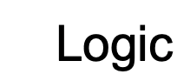
Abstract Specification
Logic Model
Logic Model
Concrete Implementation
Context: A “physical” hack computer has been constructed
Goal: From ASM to Machine code
Criteria:
Remove comments
Map line to line
Add labels
Output: A program that translate ASM to Hack Machine code
Process: Code and Test
Input:
ASM dictionary and grammar
High level programming language
ASM testing suite
A well-defined set of Actions and iterative Branching Strategies
A Roadmap of composable activities
Sequencing and timing conditions
Explicitly state dependencies and resource requirements
Boundary Conditions: Familiarity with the architecture of Hack Computer and syntax of Hack Assembly

Slide 3
Where we are at:
Human
Abstract design
Software
Thought
abstract interface
hierarchy
Chapters 9, 12
H.L. Language
Compiler
&
abstract interface
Operating Sys.
Chapters 10 - 11
Virtual
VM Translator
Machine
abstract interface
Chapters 7 - 8
Assembly
Language
Assembler
Chapter 6
abstract interface
Computer
Machine
Architecture
Language
abstract interface
Chapters 4 - 5
Gate Logic
Hardware
abstract interface
Platform
Chapters 1 - 3
Electrical
Hardware
Chips &
Engineering
Logic Gates
Physics
hierarchy

Slide 4
Why care about assemblers?
Because …
Assemblers employ nifty programming tricks
Assemblers are the first rung up the software hierarchy ladder
An assembler is a translator of a simple language
Writing an assembler = low-impact practice for writing compilers.

Slide 5
The Main Software Pattern in this course
Main
Symbol Table
Source Code
Traget Code
Parser
Code Generator

Slide 6
Proposed assembler implementation
An assembler program can be written in any high-level language.
We propose a language-independent design, as follows.
Software modules:
Parser: Unpacks each command into its underlying fields
Code: Translates each field into its corresponding binary value, and assembles the resulting values
SymbolTable: Manages the symbol table
Main: Initializes I/O files and drives the show.
Proposed implementation stages
Stage I: Build a basic assembler for programs with no symbols
Stage II: Extend the basic assembler with symbol handling capabilities.

Slide 7
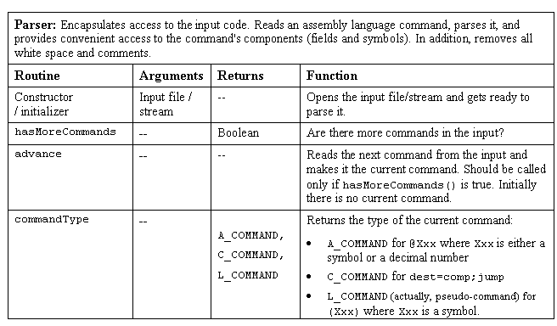

Parser

Slide 8
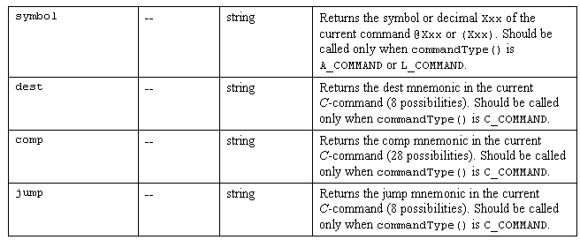
Parser (a software module in the assembler program) / continued

Slide 9
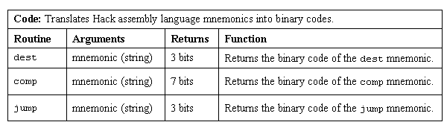
Code Generator

Slide 10
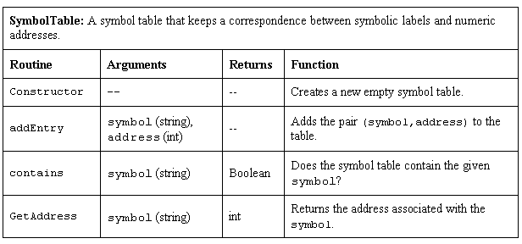
SymbolTable (a software module in the assembler program)

Slide 11
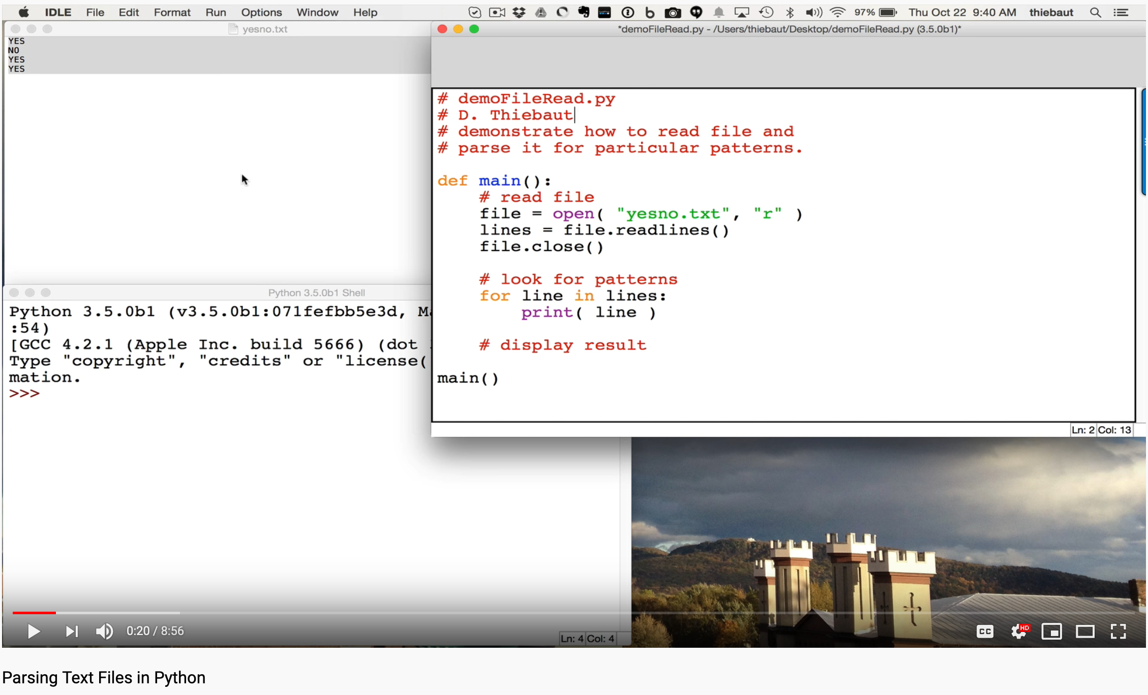
Parsing Text File in Python
https://youtu.be/1uA-pLITer0

Slide 12
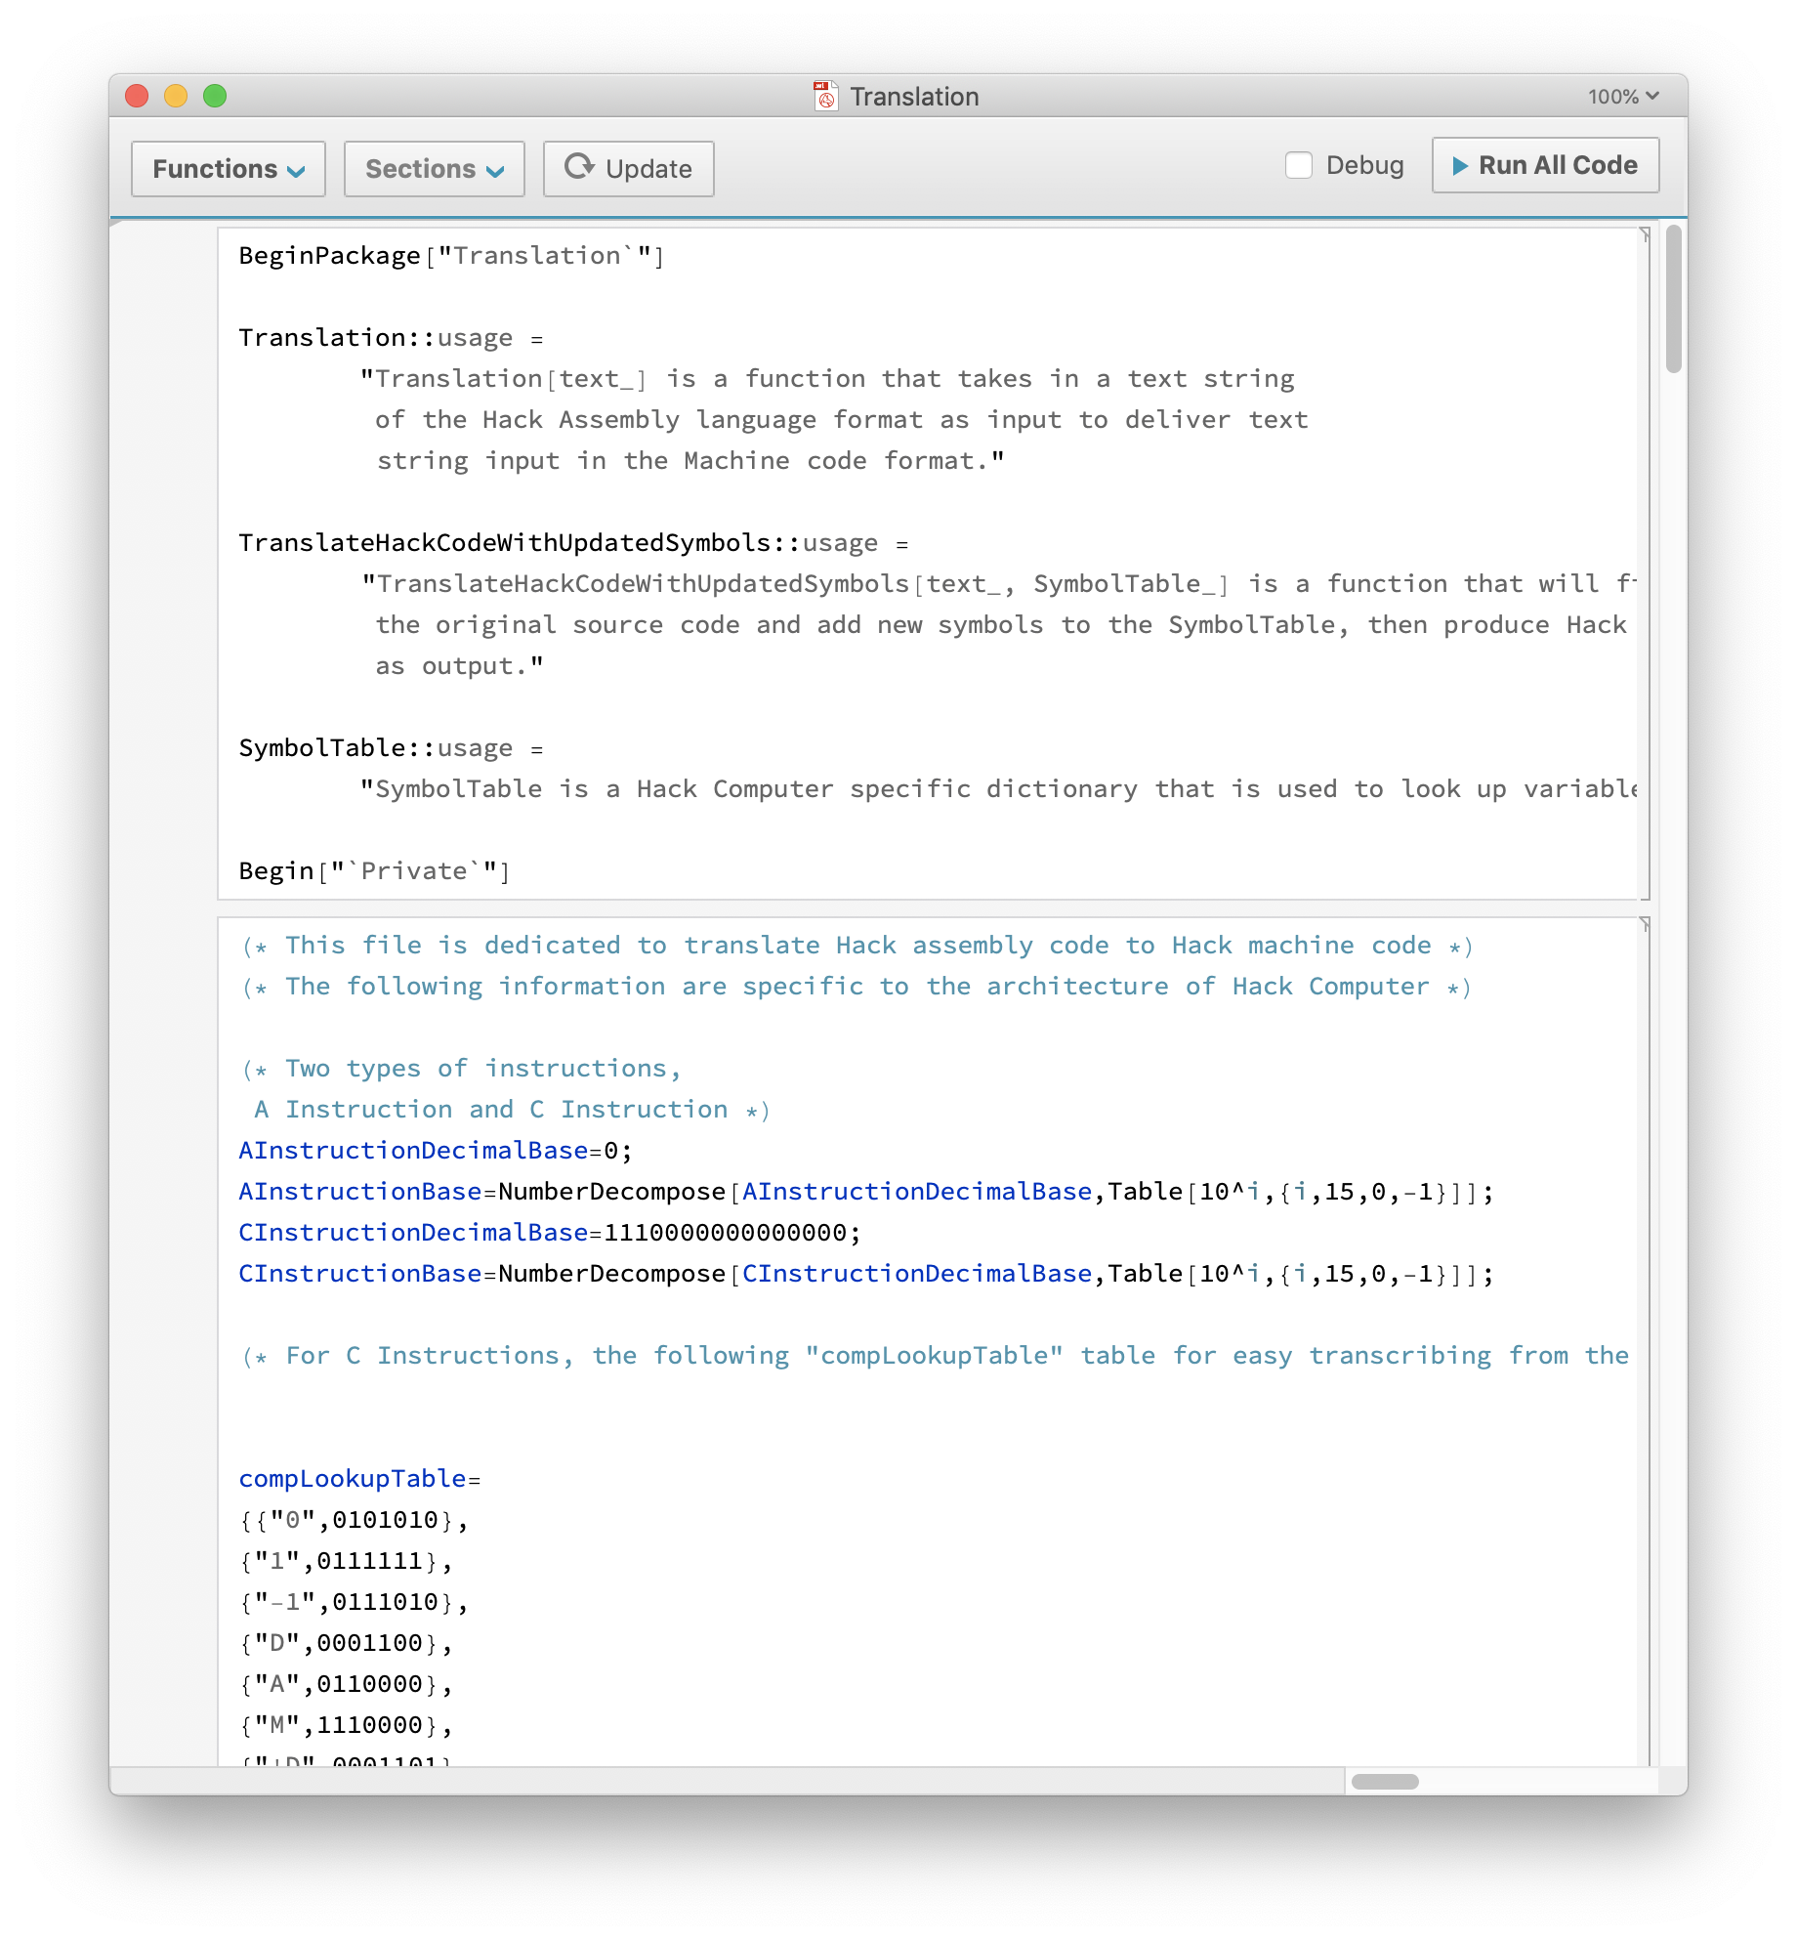
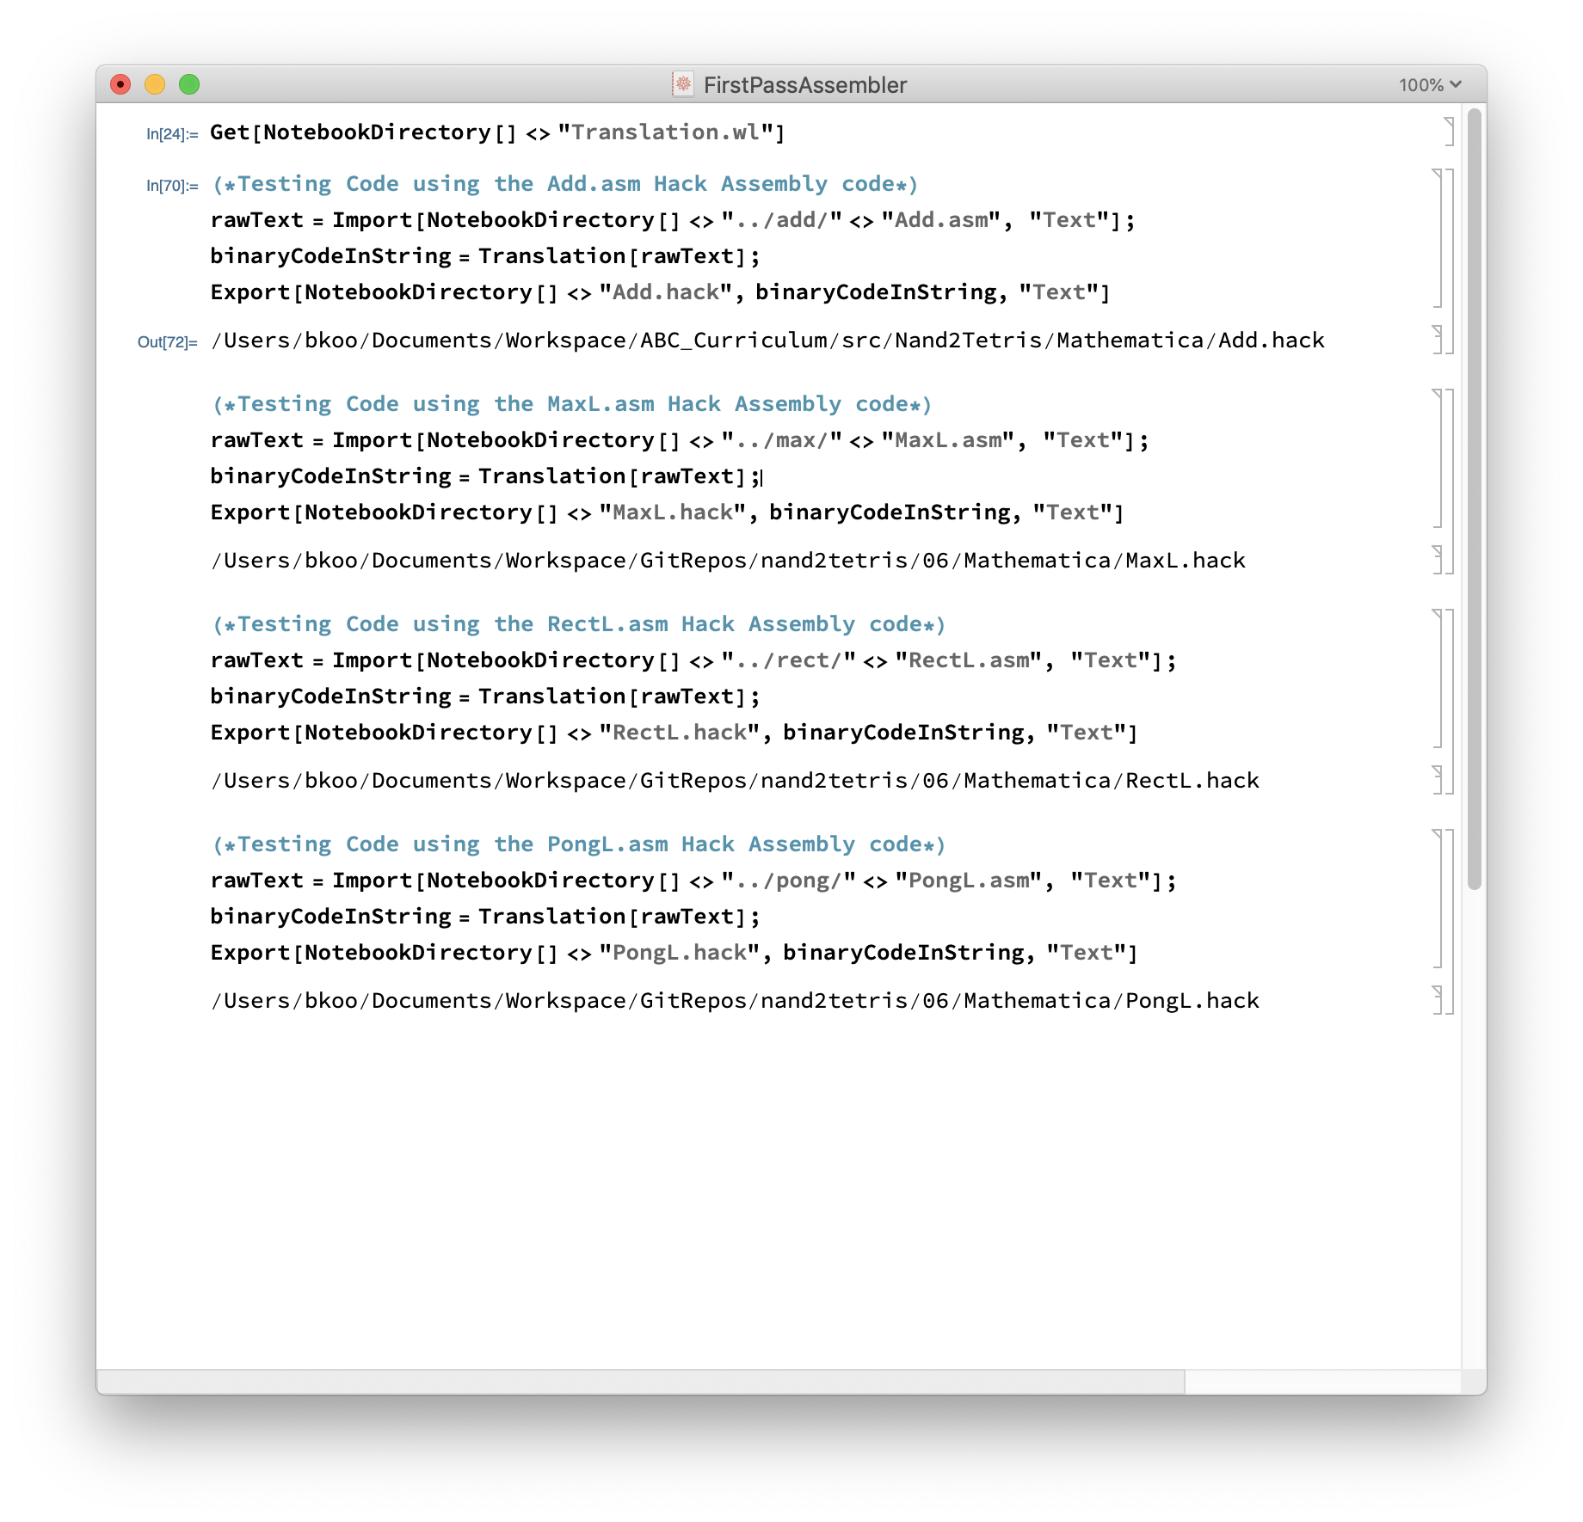
Implementation in Mathematica

Slide 13
Assembly example
For now, ignore all details!
Source code (example)
Target code
// Computes 1+...+RAM[0]
// And stored the sum in RAM[1]
@i
M=1 // i = 1
@sum
M=0 // sum = 0
(LOOP)
@i // if i>RAM[0] goto WRITE
D=M
@R0
D=D-M
@WRITE
D;JGT
... // Etc.
0000000000010000
1110111111001000
0000000000010001
1110101010001000
0000000000010000
1111110000010000
0000000000000000
1111010011010000
0000000000010010
1110001100000001
0000000000010000
1111110000010000
0000000000010001
...
assemble
execute
The program translation challenge
Extract the program’s semantics from the source program, using the syntax rules of the source language
Re-express the program’s semantics in the target language, using the syntax rules of the target language
Assembler = simple translator
Translates each assembly command into one or more binary machine instructions
Handles symbols (e.g. i, sum, LOOP, …).

Slide 14
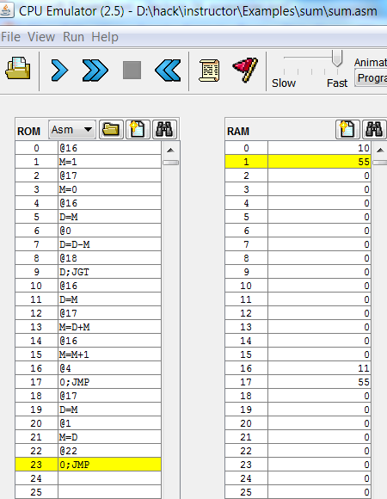
Revisiting Hack low-level programming: an example
Assembly program (sum.asm)
CPU emulator screen shot after running this program
// Computes 1+...+RAM[0]
// And stores the sum in RAM[1].
@i
M=1 // i = 1
@sum
M=0 // sum = 0
(LOOP)
@i // if i>RAM[0] goto WRITE
D=M
@0
D=D-M
@WRITE
D;JGT
@i // sum += i
D=M
@sum
M=D+M
@i // i++
M=M+1
@LOOP // goto LOOP
0;JMP
(WRITE)
@sum
D=M
@1
M=D // RAM[1] = the sum
(END)
@END
0;JMP
user supplied input
program generated output
The CPU emulator allows loading and executing symbolic Hack code. It resolves all the symbolic symbols to memory locations, and executes the code.

Slide 15
The assembler’s view of an assembly program
Assembly program
// Computes 1+...+RAM[0]
// And stores the sum in RAM[1].
@i
M=1 // i = 1
@sum
M=0 // sum = 0
(LOOP)
@i // if i>RAM[0] goto WRITE
D=M
@0
D=D-M
@WRITE
D;JGT
@i // sum += i
D=M
@sum
M=D+M
@i // i++
M=M+1
@LOOP // goto LOOP
0;JMP
(WRITE)
@sum
D=M
@1
M=D // RAM[1] = the sum
(END)
@END
0;JMP
Assembly program = a stream of text lines, each being one of the following:
A-instruction
C-instruction
Symbol declaration: (SYMBOL)
Comment or white space: // comment
The challenge:
Translate the program into a sequence of 16-bit instructions that can be executed by the target hardware platform.
Notes:
15

Slide 16
Translating / assembling A-instructions
Translation to binary:
If value is a non-negative decimal number, simple
If value is a symbol, later.

Slide 17
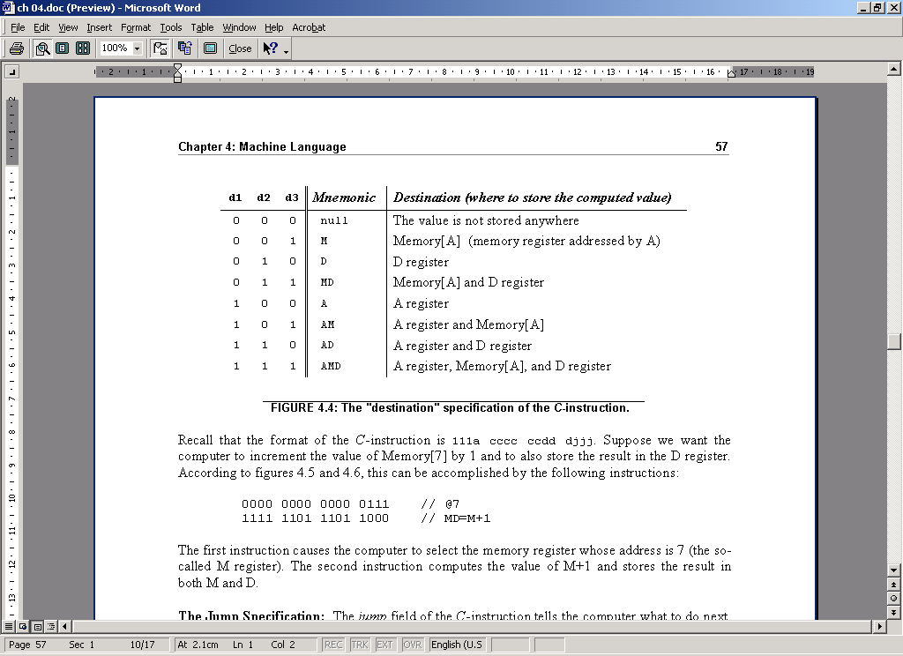
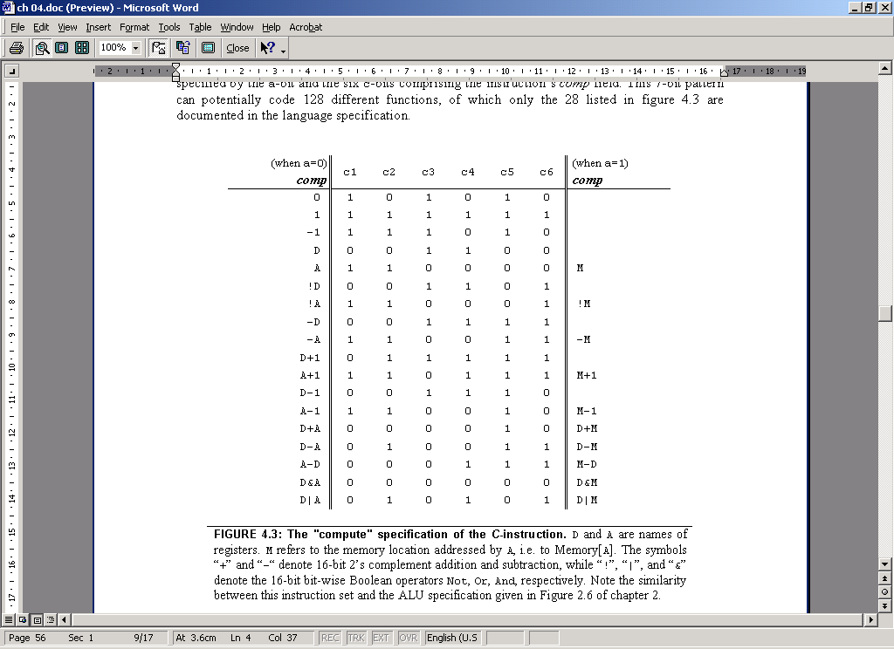
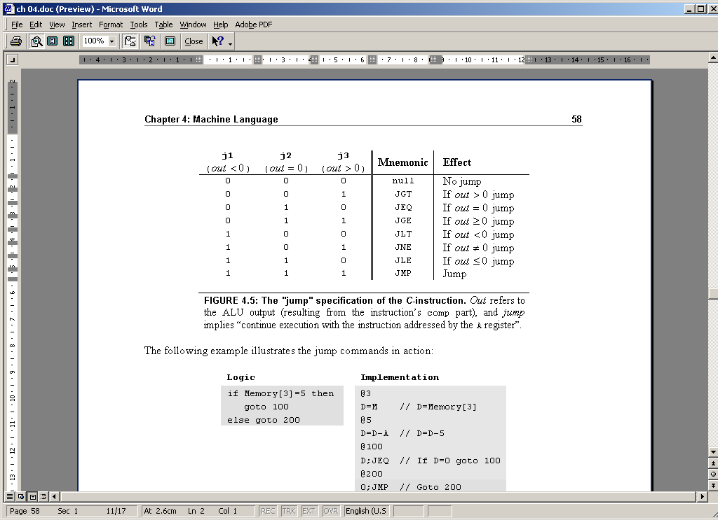
Translating / assembling C-instructions
Translation to binary: simple!

Slide 18
The overall assembly logic
Assembly program
For each (real) command
Parse the command, i.e. break it into its underlying fields
A-instruction: replace the symbolic reference (if any) with the corresponding memory address, which is a number
(how to do it, later)
C-instruction: for each field in the instruction, generate the corresponding binary code
Assemble the translated binary codes into a complete 16-bit machine instruction
Write the 16-bit instruction to the output file.
// Computes 1+...+RAM[0]
// And stores the sum in RAM[1].
@i
M=1 // i = 1
@sum
M=0 // sum = 0
(LOOP)
@i // if i>RAM[0] goto WRITE
D=M
@0
D=D-M
@WRITE
D;JGT
@i // sum += i
D=M
@sum
M=D+M
@i // i++
M=M+1
@LOOP // goto LOOP
0;JMP
(WRITE)
@sum
D=M
@1
M=D // RAM[1] = the sum
(END)
@END
0;JMP

Slide 19
Handling symbols (aka symbol resolution)
Typical symbolic Hack assembly code:
@R0
D=M
@END
D;JLE
@counter
M=D
@SCREEN
D=A
@x
M=D
(LOOP)
@x
A=M
M=-1
@x
D=M
@32
D=D+A
@x
M=D
@counter
MD=M-1
@LOOP
D;JGT
(END)
@END
0;JMP
Assembly programs typically have many symbols:
Labels that mark destinations of goto commands
Labels that mark special memory locations
Variables
These symbols fall into two categories:
User–defined symbols (created by programmers)
Pre-defined symbols (used by the Hack platform).
Notes:
19

Slide 20
Typical symbolic Hack assembly code:
Handling symbols: user-defined symbols
Label symbols: Used to label destinations of goto commands. Declared by the pseudo-command (XXX). This directive defines the symbol XXX to refer to the instruction memory location holding the next command in the program
Variable symbols: Any user-defined symbol xxx appearing in an assembly program that is not defined elsewhere using the (xxx) directive is treated as a variable, and is automatically assigned a unique RAM address, starting at RAM address 16
(why start at 16? Later.)
By convention, Hack programmers use lower-case and upper-case to represent variable and label names, respectively
@R0
D=M
@END
D;JLE
@counter
M=D
@SCREEN
D=A
@x
M=D
(LOOP)
@x
A=M
M=-1
@x
D=M
@32
D=D+A
@x
M=D
@counter
MD=M-1
@LOOP
D;JGT
(END)
@END
0;JMP
Q: Who does all the “automatic” assignments of symbols to RAM addresses?
A: As part of the program translation process, the assembler resolves all the symbols into RAM addresses.
Notes:
20

Slide 21
Typical symbolic Hack assembly code:
Handling symbols: pre-defined symbols
@R0
D=M
@END
D;JLE
@counter
M=D
@SCREEN
D=A
@x
M=D
(LOOP)
@x
A=M
M=-1
@x
D=M
@32
D=D+A
@x
M=D
@counter
MD=M-1
@LOOP
D;JGT
(END)
@END
0;JMP
Virtual registers: The symbols R0,…, R15 are automatically predefined to refer to RAM addresses 0,…,15
I/O pointers: The symbols SCREEN and KBD are automatically predefined to refer to RAM addresses 16384 and 24576, respectively (base addresses of the screen and keyboard memory maps)
VM control pointers: the symbols SP, LCL, ARG, THIS, and THAT (that don’t appear in the code example on the right) are automatically predefined to refer to RAM addresses 0 to 4, respectively
(The VM control pointers, which overlap R0,…, R4 will come to play in the virtual machine implementation, covered in the next lecture)
Q: Who does all the “automatic” assignments of symbols to RAM addresses?
A: As part of the program translation process, the assembler resolves all the symbols into RAM addresses.
Notes:
21

Slide 22
Handling symbols: symbol table
Source code (example)
Symbol table
// Computes 1+...+RAM[0]
// And stored the sum in RAM[1]
@i
M=1 // i = 1
@sum
M=0 // sum = 0
(LOOP)
@i // if i>RAM[0] goto WRITE
D=M
@R0
D=D-M
@WRITE
D;JGT
@i // sum += i
D=M
@sum
M=D+M
@i // i++
M=M+1
@LOOP // goto LOOP
0;JMP
(WRITE)
@sum
D=M
@R1
M=D // RAM[1] = the sum
(END)
@END
0;JMP
R0 0
R1 1
R2 2
... ...
R15 15
SCREEN 16384
KBD 24576
SP 0
LCL 1
ARG 2
THIS 3
THAT 4
WRITE 18
END 22
i 16
sum 17
This symbol table is generated by the assembler, and used to translate the symbolic code into binary code.

Slide 23
Handling symbols: constructing the symbol table
Source code (example)
Symbol table
// Computes 1+...+RAM[0]
// And stored the sum in RAM[1]
@i
M=1 // i = 1
@sum
M=0 // sum = 0
(LOOP)
@i // if i>RAM[0] goto WRITE
D=M
@R0
D=D-M
@WRITE
D;JGT
@i // sum += i
D=M
@sum
M=D+M
@i // i++
M=M+1
@LOOP // goto LOOP
0;JMP
(WRITE)
@sum
D=M
@R1
M=D // RAM[1] = the sum
(END)
@END
0;JMP
R0 0
R1 1
R2 2
...
R15 15
SCREEN 16384
KBD 24576
SP 0
LCL 1
ARG 2
THIS 3
THAT 4
WRITE 18
END 22
i 16
sum 17
Initialization: create an empty symbol table and populate it with all the pre-defined symbols
First pass: go through the entire source code, and add all the user-defined label symbols to the symbol table (without generating any code)
Second pass: go again through the source code, and use the symbol table to translate all the commands. In the process, handle all the user-defined variable symbols.

Slide 24
The assembly process (detailed)
Initialization: create the symbol table and initialize it with the pre-defined symbols
First pass: march through the source code without generating any code. For each label declaration (LABEL) that appears in the source code, add the pair <LABEL , n > to the symbol table
Second pass: march again through the source code, and process each line:
If the line is a C-instruction, simple
If the line is @xxx where xxx is a number, simple
If the line is @xxx and xxx is a symbol, look it up in the symbol table and proceed as follows:
If the symbol is found, replace it with its numeric value and complete the command’s translation
If the symbol is not found, then it must represent a new variable: add the pair <xxx , n > to the symbol table, where n is the next available RAM address, and complete the command’s translation.
(Platform design decision: the allocated RAM addresses are running, starting at address 16).

Slide 25
The result ...
Source code (example)
Target code
// Computes 1+...+RAM[0]
// And stored the sum in RAM[1]
@i
M=1 // i = 1
@sum
M=0 // sum = 0
(LOOP)
@i // if i>RAM[0] goto WRITE
D=M
@R0
D=D-M
@WRITE
D;JGT
@i // sum += i
D=M
@sum
M=D+M
@i // i++
M=M+1
@LOOP // goto LOOP
0;JMP
(WRITE)
@sum
D=M
@R1
M=D // RAM[1] = the sum
(END)
@END
0;JMP
0000000000010000
1110111111001000
0000000000010001
1110101010001000
0000000000010000
1111110000010000
0000000000000000
1111010011010000
0000000000010010
1110001100000001
0000000000010000
1111110000010000
0000000000010001
1111000010001000
0000000000010000
1111110111001000
0000000000000100
1110101010000111
0000000000010001
1111110000010000
0000000000000001
1110001100001000
0000000000010110
1110101010000111
assemble
Note that comment lines and pseudo-commands (label declarations) generate no code.

Slide 26
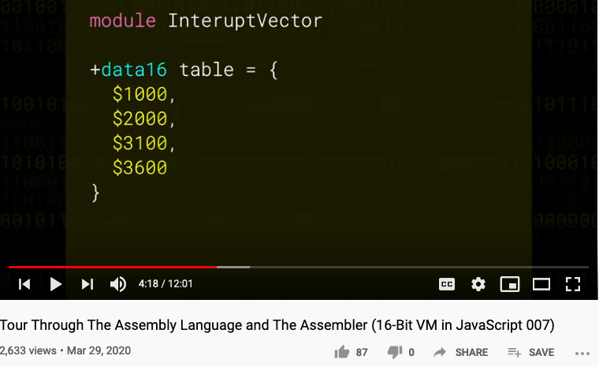
A Series of Low Level Programming Tutorial
Playlist : Low Level JavaScript

Slide 27
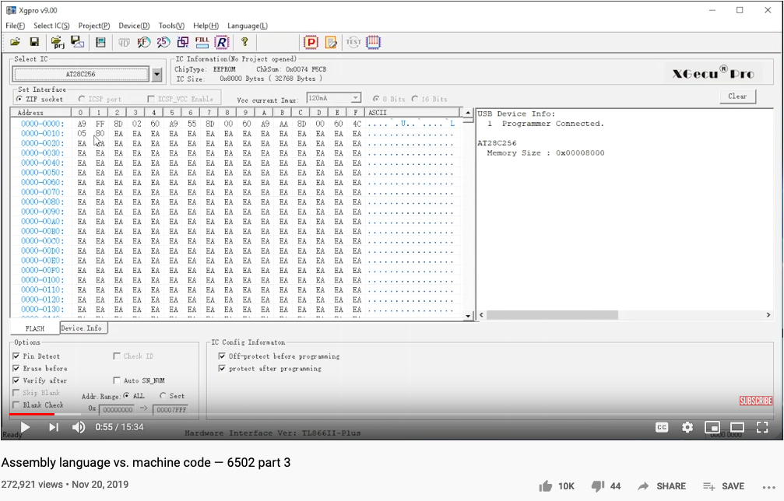
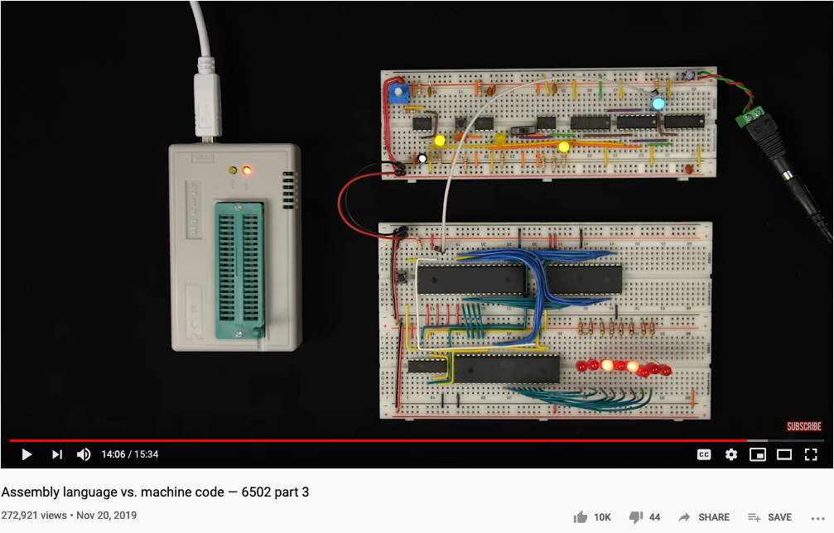
Ben Eater’s 6502 Assembly to Machine Code

Slide 28
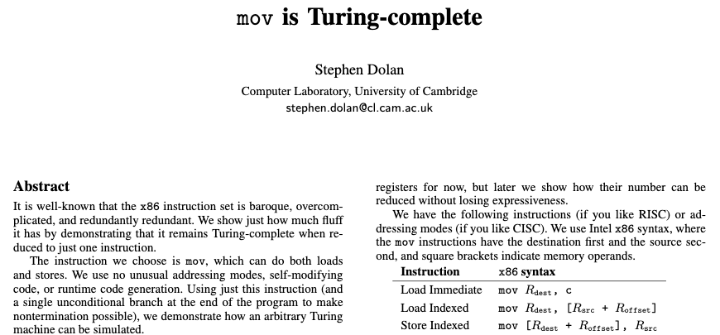
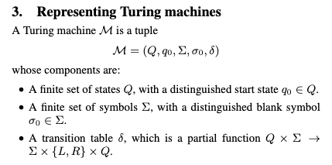
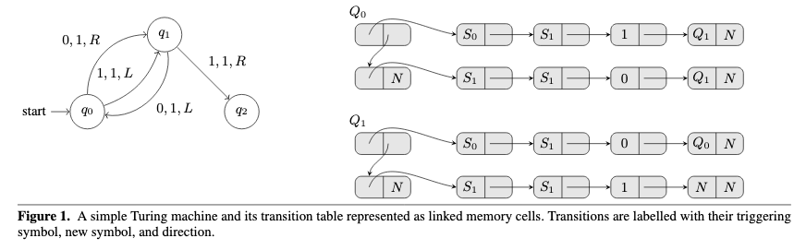
Turing Complete Instruction Set
Paper Download Link: https://drwho.virtadpt.net/files/mov.pdf

Slide 29
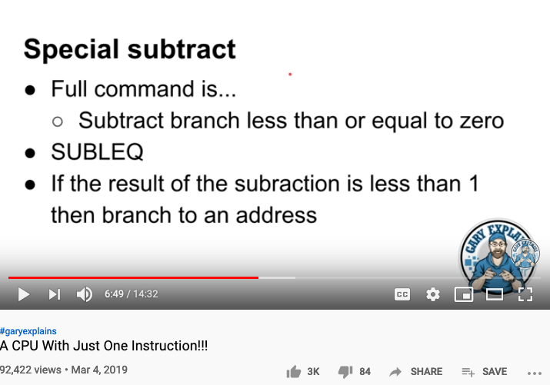
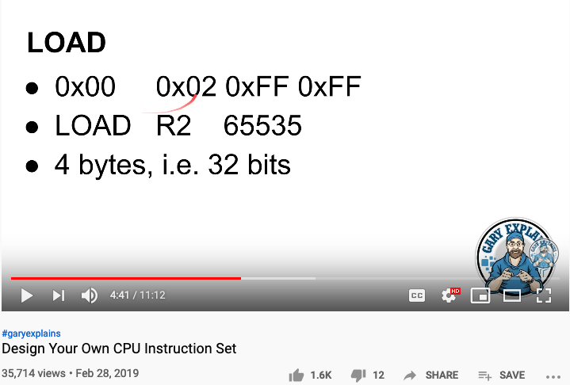
SUBLEQ as the ONLY instruction
https://youtu.be/jRZDnetjGuo?t=409
https://youtu.be/wjHlvQfo5uI

Slide 30
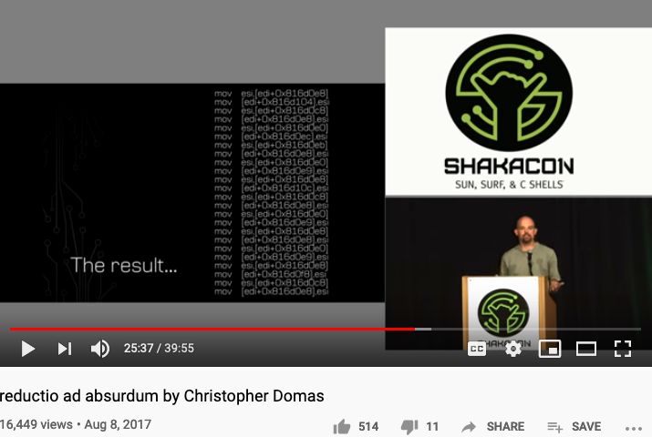
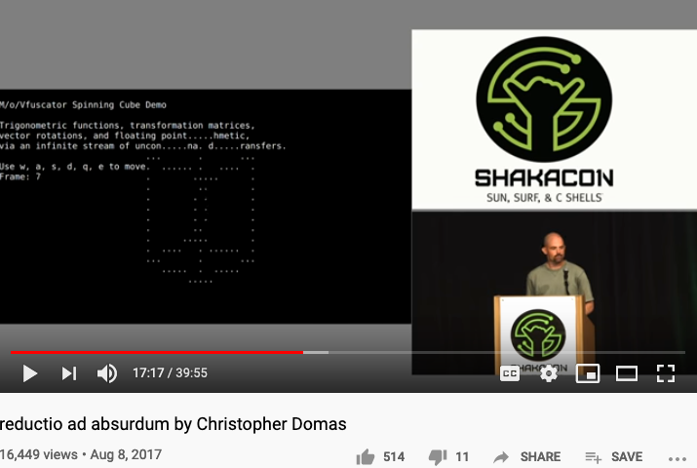
One instruction for All Computation
https://youtu.be/NmWwRmvjAE8?t=1037
Representing all computational actions with just one instruction, MOV

Slide 31
Why are Names important?
A generic pool of conceptual handles for computation
Some times it is better to keep all names (terms) neutral
By assigning unique and countable names to a domain, it allows the naming systems to be reused or evolved for future use.
Many of the computing/logical systems are universal
They can be reused by many applications
Logical Systems have been studied extensively, and may possess desirable properties
Soundness and Completeness

Slide 32
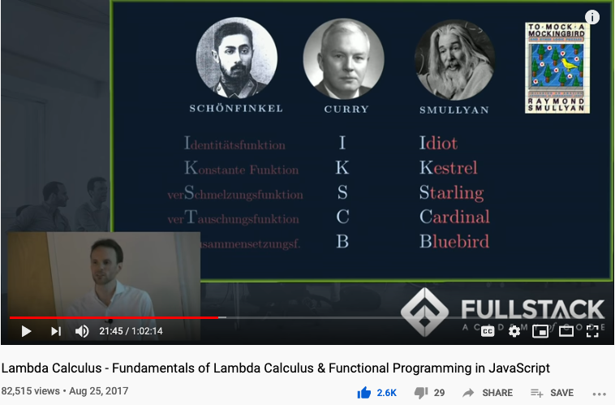
Computable Logic and Types of “Birds”

Slide 33
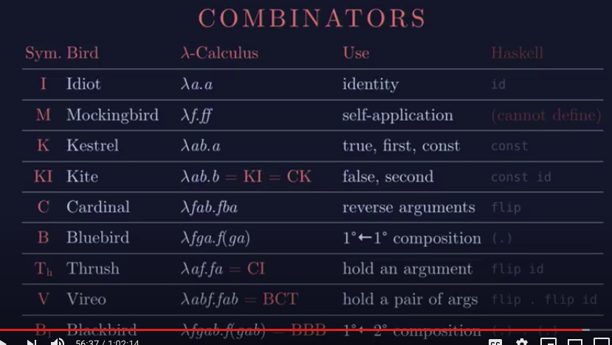
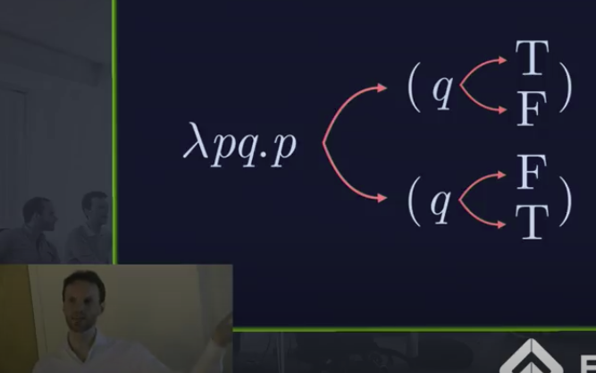
The Names of Birds (Functions)

Slide 34
Perspective
Simple machine language, simple assembler
Most assemblers are not stand-alone, but rather encapsulated in a translator of a higher order
C programmers that understand the code generated by a C compiler can improve their code considerably
C programming (e.g. for real-time systems) may involve re-writing critical segments in assembly, for optimization
Writing an assembler is an excellent practice for writing more challenging translators, e.g. a VM Translator and a compiler, as we will do in the next lectures.

Slide 35
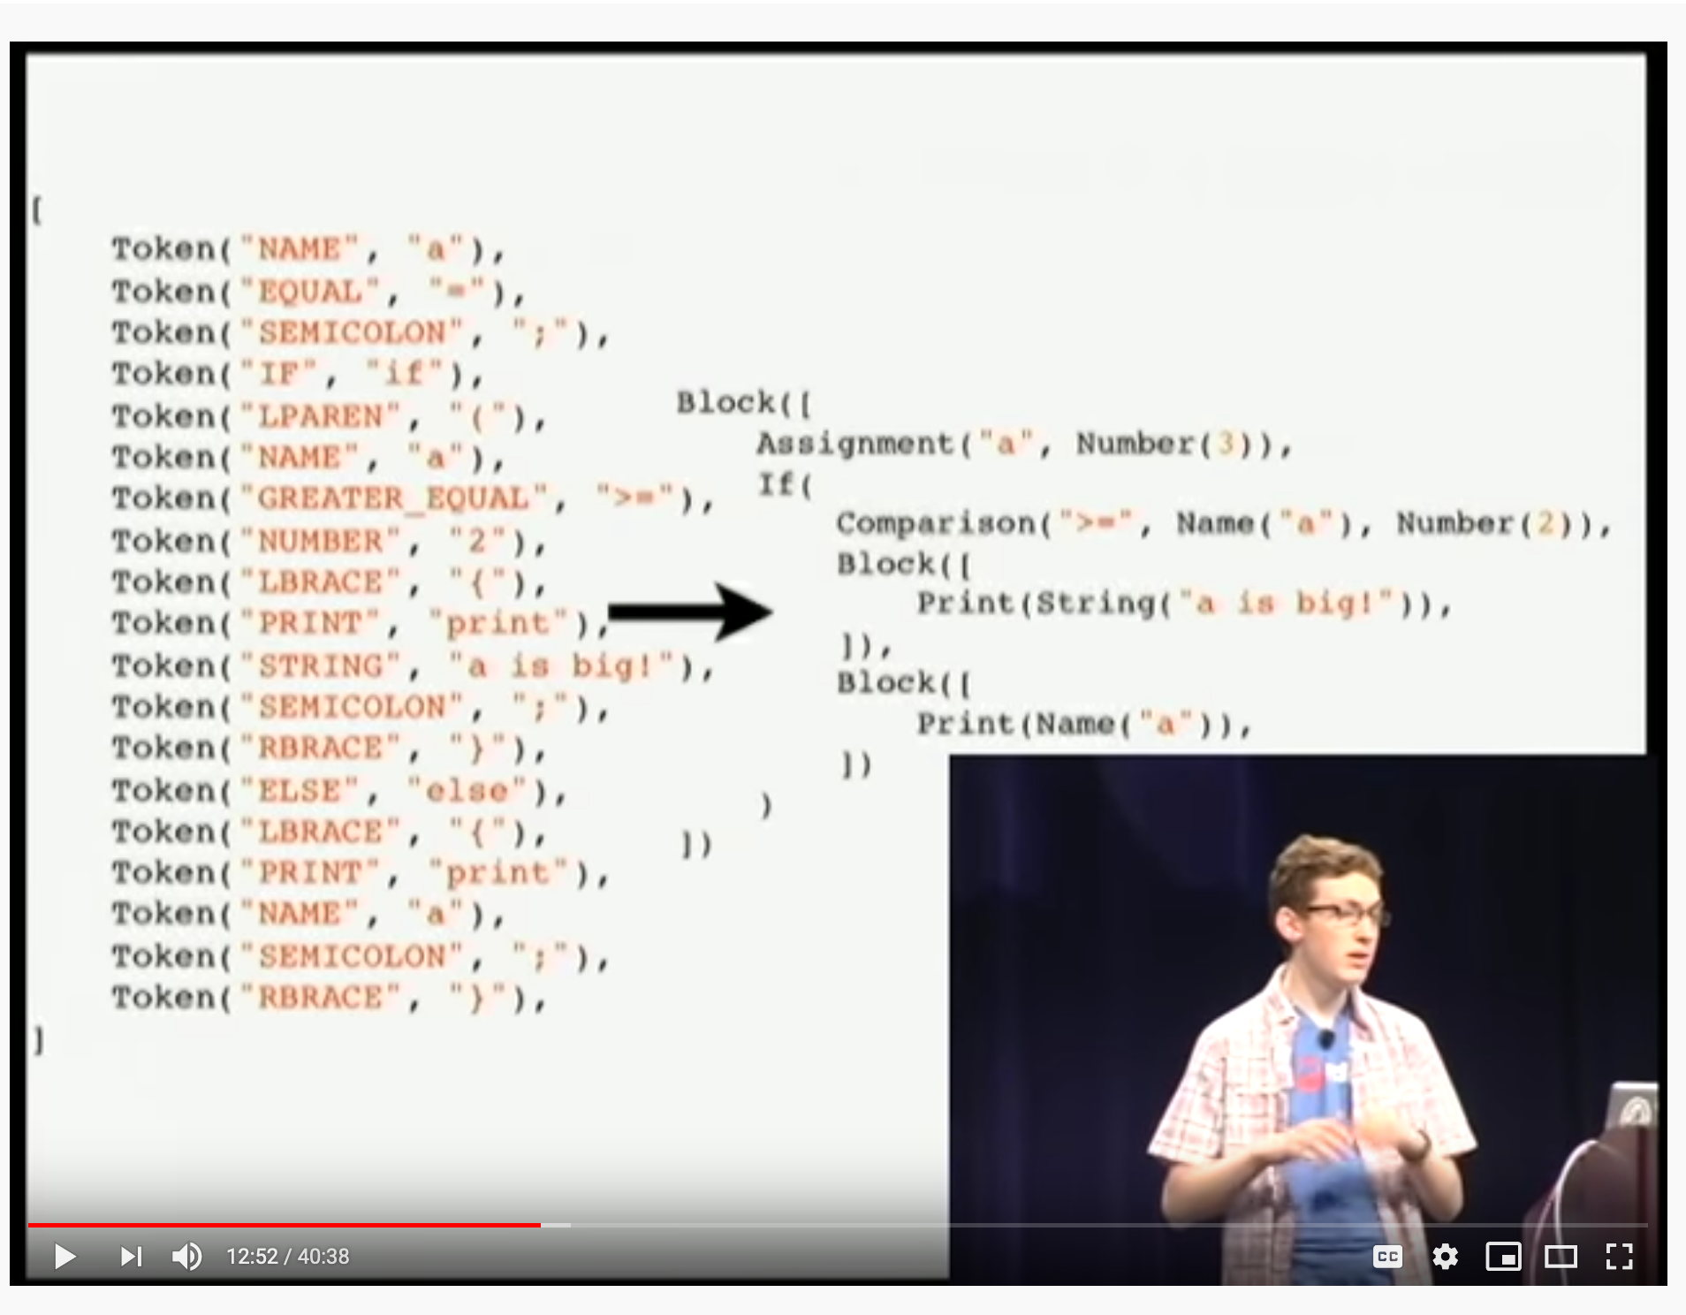
参考文献:
视频:
Coursera Video website: https://www.coursera.org/learn/build-a-computer
How to write an Interpreter : https://youtu.be/LCslqgM48D4.

Slide 36
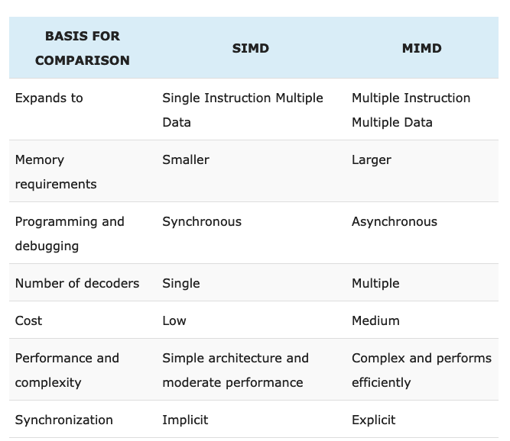
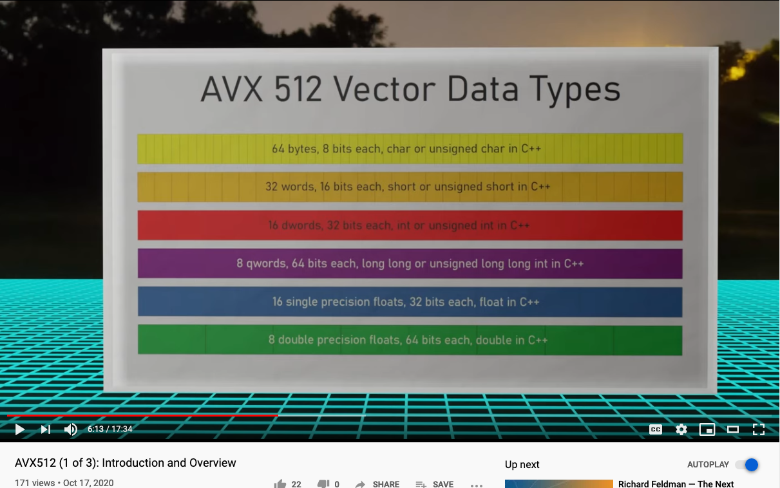
SIMD and MIMD
SIMD: Single Instruction Multiple Data
MIMD: Multiple Instructions Multiple Data
An industry example: Intel AVX512 Instruction Set
https://techdifferences.com/difference-between-simd-and-mimd.html

Slide 37
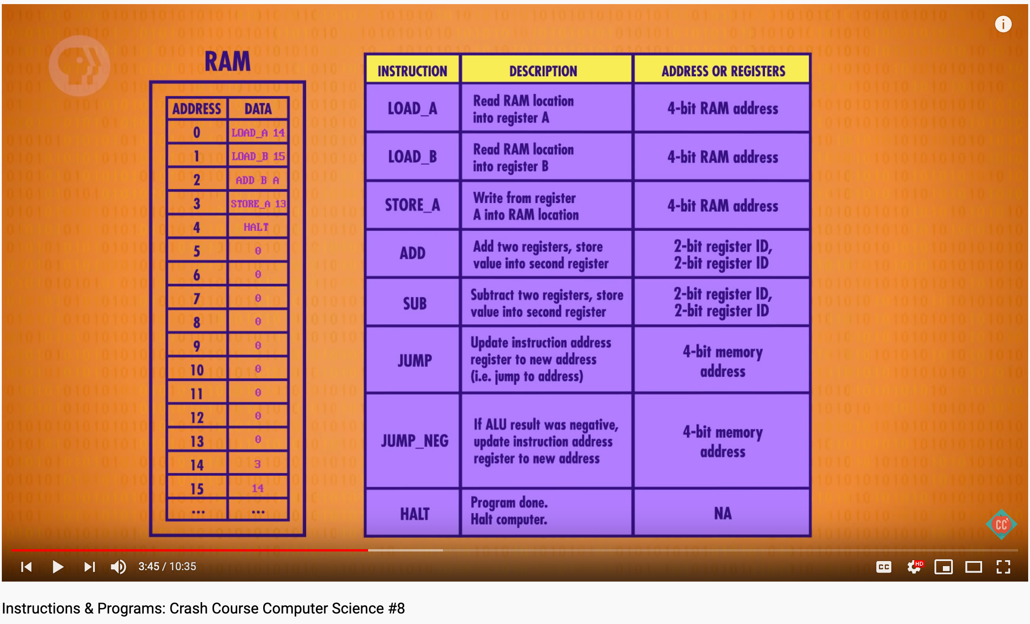
Instructions & Programs: Crash Course CS #8
https://youtu.be/zltgXvg6r3k
Notes:
37

